Slide 1

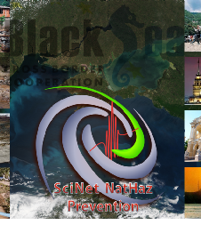

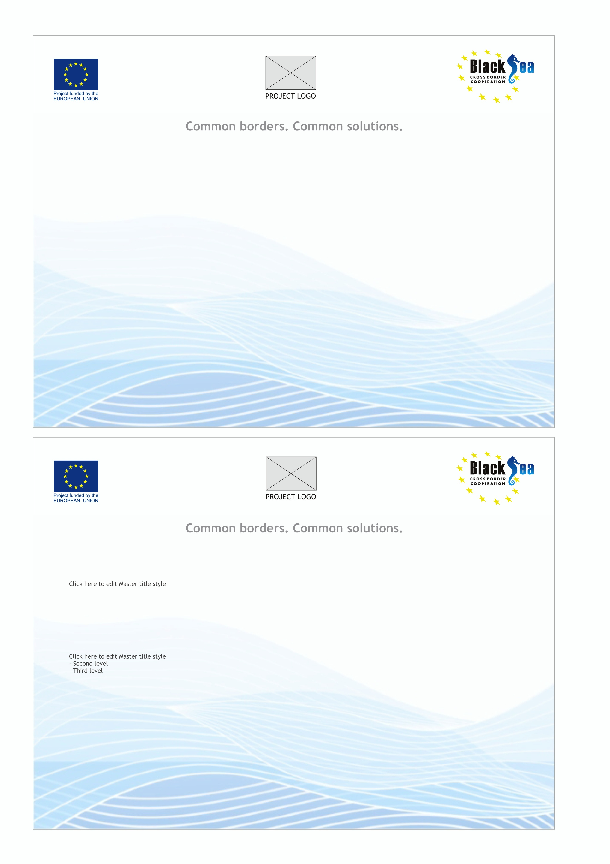
Natural Hazard Prevention and Management in the wider Black Sea area: the “SciNetNatHaz” Project
Papatheodorou Konstantinos¹, Klimis Nikolaos², Basil Margaris³, Ntouros Konstantinos¹, Evangelidis Konstantinos¹, Konstantinidis Alexandros^{1.}
1. Technological Educational Institute of Kentriki Makedonia, Dept. of Civil, Surveying and Geoinformatics Engineering, Hellas; 2. Democritus University of Thrace, Hellas; 3. Institute of Engineering Seismology & Earthquake Design, Thessaloniki, Hellas

Slide 2
Contents
A Brief Review of
EU Activities including legislation, establishment of organizations, bodies etc regarding Natural Hazard Mitigation
Overview of more than 50 Projects funded by the EU (FP5, FP6, FP7, CORDIS…)
Natural Hazard Mitigation issues targeted in EU funded Programmes
Outcomes, remaining issues – Potential present & future priorities
The SciNetNatHaz Project

Slide 3
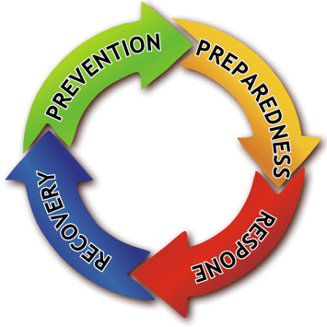
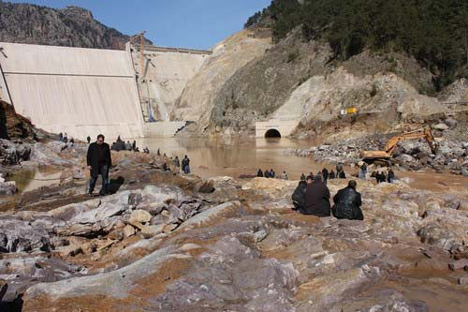
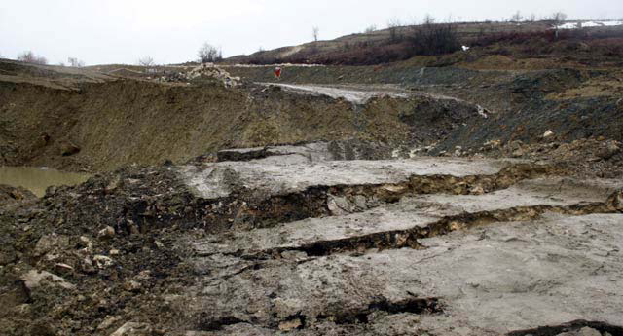
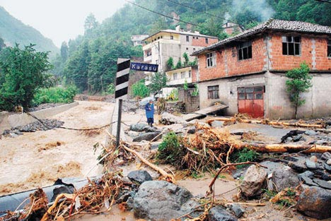
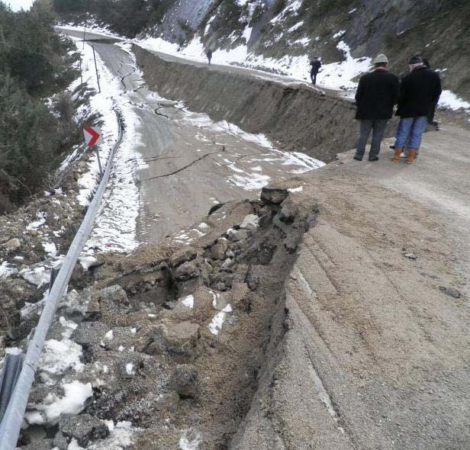
Natural Hazards: The “mitigation” cycle
Unforeseen events
Poorly assessed location and/or magnitude of events
No actions taken due to various reasons (economic, etc)
Lack of public awareness
….and more ….
Vulnerability & Insufficient Capacity to Reduce the RISK
Notes:
pre-event measures are the most cost effective, provided that they are based on accurate and reliable Hazard Identification and Risk Assessment …and the same stands for the rest of the Mitigation Process stages (effective planning etc)
Hazard Identification and Risk Assessment MUST based on:
Accurate and Reliable Data
Scientifically proven (after being adapted to local conditions, tested and accepted) Methodologies
Hazard Identification and Risk Assessment provide the background needed
…and both of these are based & improved by
Applied Research and Technology transfer

Slide 4
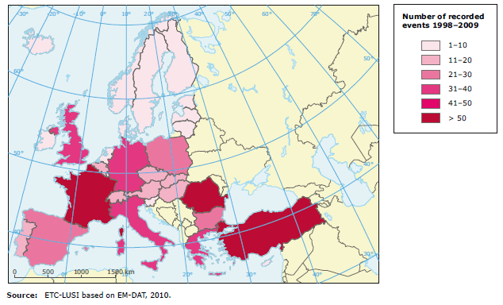
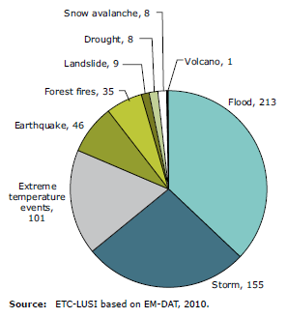
Natural Hazards in Europe
Disastrous events recorded in
EM-DAT by hazard type in
1998–2009
Number of disastrous events recorded in EM-DAT by country in 1998–2009

Slide 5

…and the EU Response:
Directives issued,
bodies formed,
Organizations established

Slide 6
The Soil Thematic Strategy
The Directive 2007/60/EC of the European Parliament and of the Council of 23 October 2007 on the assessment and management of flood risks
The Report of the “Committee of Energy, Research and Technology” on the establishment of a European research area and regional planning measures for protection against earthquakes.
The Commission of the European Community (1975): Harmonization on structural design codes & technical specifications: Eurocode 8
The Directorate General for Research & Innovation has funded more that 50 research Projects on Earthquake Hazard mitigation since 1987.
The Convention on the Protection and Use of Transboundary Watercourses and International Lakes (Water Convention) (1996)
the “Task Force on Flood Prevention and Protection”
the Hyogo framework for Action 2005-2015: “Building the resilience of nations and communities to disasters”
Directives, bodies, Organizations
Notes:
The problem in Europe has been recognized by the EU and numerous actions have been taken. A list of selected actions is shown

Slide 7
the EUR-OPA Major Hazards Agreement : a platform for co-operation in the area of major natural and technological disasters
The European Advisory Evaluation Committee for Earthquake Prediction (EAECEP) June 10,
The European Warning (Alarm) System established to support information and cooperation between the Member States
the Euro-Mediterranean Seismological Center (CSEM/EMSC)
the “Community Research and Development Information Society (CORDIS)” which has funded more than 50 projects under different calls (programmes)
The Joint Research Centre (JRC)
The European Centre on Geomorphological Hazards (CERG)
The European Flood Alert System (between Austria and the Czech Republic on the Morava River basin).
the UNECE Water Convention and the European Union (EU) Directives
The Associated Programme on Flood Management (APFM) of the World Meteorological Organization (WMO)
The European Flood Alert System and those provided by the European Exchange Circle on Flood Forecasting (EXCIFF)
The European Exchange Circle on Flood Mapping (EXCIMAP)
The European Flood Awareness System (EFAS)
The Flood Mitigation Action
A lot of projects have been and are also funded by the European Neighbourhood and Partnership Instrument (ENPI) and from the Instrument of Pre-accession Assistance (IPA) including Inter-regional Projects (INTERREG, Black Sea basin JOP 2007-13)
EU Bodies & Services

Slide 8
Research Projects funded in the framework of various Programmes
(FP5, FP6, FP7, CORDIS, INTERREG, Black Sea Basin JOP 2007-13… )
Notes:
RESEARCH PROJECTS FUNDED

Slide 9
EARTHQUAKES
LESSLOSS: The scope is to improve risk mitigation for earthquakes and landslides.
SAFER: effective earthquake early warning in Europe.
SEAHELLARC: establish a real-time on/offshore network for simultaneous seismic and tsunami observations
TRANSFER: understanding of tsunami processes in the Euro-Mediterranean region
NERIES: networking the European seismic networks.
The International Consortium on Landslides (ICL): landslide risk reduction (supported by UNESCO, UN/ISDR, FAO, WMO)
FLOODS
Flood Management plans according to the 2007/60/EC Directive.
The RIBAMOD (River Basin Modeling, Management and flood mitigation).
EFFS - European Flood Forecasting System.
FLOODMAN - Near real time flood forecasting, warning and management system
SPHERE – Systematic, Palaeoflood and Historical Data for the improvement of flood Risk Estimation
Research Projects (1/3)

Slide 10
The CRUE ERA-NET project which “aims to introduce structure within the area of European Flood Research by improving co-ordination between national programmes.
The Project "RIVERCROSS - Cross-border cooperation on flood basin River Evros / Maritza / Meric : transboundary water management.
"Observation of quantitative and qualitative characteristics of rivers Erythropotamos, Ardas and Evros Region Eastern Macedonia and Thrace“: flood forecasting system.
FLOODSite – Integrated Flood Risk Analysis and Management Methodologies: physical, environmental, ecological and socio-economic aspects of floods from rivers, estuaries and the sea.
Regional Strategy for Disaster Prevention -CivPro.
The “FLINKMAN” project : development of a suitable framework through the preparation of a flood management plan.
Project SEE/A/118/2.2/X: Practical Use of MONITORing in Natural Disaster Management – Project “MONITOR II”: improve communication among Disaster Management Experts.
Project FLAPP – Flood Prevention in Border Areas
Flood warning system establishment in Arda river basin for minimising the risk in the cross border area (ARDAFORECAST).
Project FLoods and fIre Risk assessment – FLIRE.
FLOODRELIEF: REaL-tImE Flood Decision Support System Integrating Hydrological, Meteorological and Remote Sensing Technologies.
ECOFLOOD: Towards Natural Flood Reduction Strategies: objective of the project is to stimulate creation of floodplains
ACTIF: Achieving Technology Innovation in Flood Forecasting.
Research Projects (2/3)

Slide 11
DESWAT project (Destructive Water Abatement and Control of Water Disasters) The program is an initiative of the Romania Ministry of Environment and Water Management (MMGA) to improve the water management authority National Administration Apele Romane (ANAR)'s flood monitoring capacity, as well as to improve its National Institute of Hydrology and Water Management flood modeling and prediction capabilities.
ROMANIAN FLASH FLOOD GUIDANCE (RO_FFG): “The objective of this technology transfer project is to design, develop and test the components of an operational flash flood guidance system for Romania. Radar rainfall estimates and a number of real time on-site precipitation sensors will be used to provide input to the system. The flash flood guidance system will be implemented by HRC at the National Institute for Hydrology and Water Management (NIHWM) in Bucharest.”
HYDRATE Project: “The HYDRATE objective is to improve the scientific basis of flash flood forecasting by extending the understanding of past flash flood events, advancing and harmonising a European-wide innovative flash flood observation strategy and developing a coherent set of technologies and tools for effective early warning systems.”
The DANUBE FLOODRISK Project within the Southeast Europe Transnational Cooperation Programme which focuses “on the most cost-effective measures for flood risk reduction: risk assessment, risk mapping, involvement of stakeholders, risk reduction by adequate spatial planning”.
A brief list of major EU funded projects related to Flood Hazard management can be found at the JRC web site: [http://ec.europa.eu/environment/water/flood_risk/links.htm#researchlinks]
Research Projects (3/3)
Notes:
DESWAT project (Destructive Water Abatement and Control of Water Disasters) The program is aiming to improve flood monitoring capacity,
HYDRATE Project: “The HYDRATE objective is to improve the scientific basis of flash flood forecasting
The DANUBE FLOODRISK Project within the Southeast Europe Transnational Cooperation Programme which focuses “on the most cost-effective measures for flood risk reduction

Slide 12
Some of the Project’s
OUTCOMES
Notes:
The problem in Europe has been recognized by the EU and numerous actions have been taken. A list of selected actions is shown

Slide 13
EU funded Research Projects – the Outcomes
FP5
Current Status Assessment
Formation of Scientific Networks
Establishment of Communication
FP6
Processes and Hazard assessment Methodologies Investigated.
First attempts based on analyzing historical data and real-time information
FP7 & CORDIS
Hazard assessment Methodologies, use of new technologies, improvement of disaster response capacity
Proposals for further Investigation
Investigation of Processes, assessment Methodologies, Hazard & Risk Assessment
Proposals for Investigation
Development of European Databases (extreme events, impact)
Study of “specific” phenomena taking place during the “event”
General Outcomes
an integrated approach to disasters is needed
Prevention is the primary target accompanied by impact assessment
Notes:
As far as the ELF Hazards are concerned: Basic Principles were assessed, basic methodological approaches were discussed but mainly, the “current status” at that time, was assessed…

Slide 14
Some basic conclusions (1/3)
  there is an ongoing effort made by the EU regarding Earthquake, Landslide and Flood Hazard Identification and Risk Assessment, evident by the Directives issued, the numerous bodies, Organizations and Services provided as well as by the large number of Research Projects funded.
  There has been great scientific work regarding all Natural hazards as a result of the Projects already implemented
  Serious problems regarding floods in large rivers are being tackled with early warning systems, preventive measures and management plans developed by the scientific community

Slide 15
Some basic conclusions (2/3)
  Problems still remaining…issues to be resolved
  All though there is great advance in cross border flood management issues, there is still a lot to be done in terms of a common approach of the flood problem in neighboring countries.
  Flash floods, which are frequent and common in most Black Sea countries, are not dealt with. This fact has already been recognized by the EU and flood management plans are foreseen to be designed during the next period of the Directive 2007/60/EC implementation.

Slide 16
Some basic conclusions (3/3)
  …Problems still remaining…issues to be resolved
  Usable Data are still lacking. Inventories of past landslides and floods do not exist or are not accessible.
  Metadata are not supplied so it’s very difficult to assess reliability and accuracy of available data (if found).
  Different methodologies are used by scientists even in the same country, making comparison of results, impossible
  Hazard identification & Risk assessment on a local scale (that could provide the essential information for planning preventive measures) has not been implemented.

Slide 17
What needs to be done
  CONSENSUS among the members of the scientific community involved in ELF mitigation regarding:
  Harmonization of METHODOLOGIES used to assess the hazards…in order to create a large network of potential partners working on the same problem, supporting each other, sharing competencies.
  DATA harmonization including METADATA creation.
  DATA collection and SHARING
  COOPERATION in all four steps of the Hazard Management cycle (“harmonization” is a pre-requisite)
Notes:
@ the end:
…and let’s move to the SciNetNatHaz Project

Slide 18

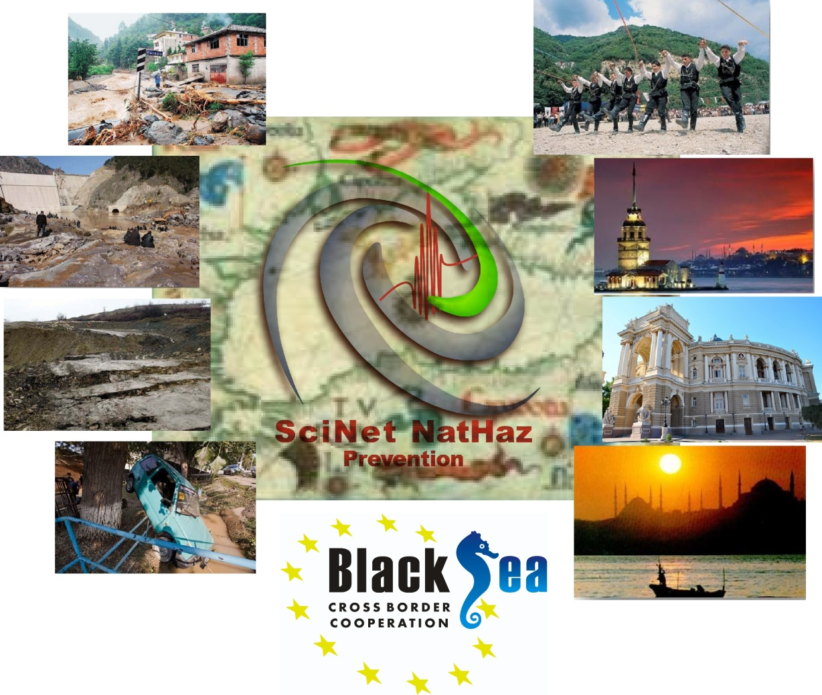
A Scientific Network for Earthquake, Landslide and Flood Hazard Prevention
The Project

Slide 19
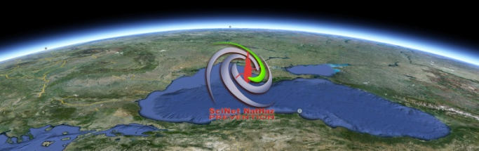
Scope of the SciNetNatHaz Project
To establish a strong regional (BS) cooperation by developing a SCIentific NETwork for Earthquake, Landslide and Flood Hazard Prevention that will set the basis for:
  Systematic data acquisition, harmonization, management and sharing with the scientific community
  Harmonization of Methodologies and Procedures adapted
  A systematic Hazard assessment
Notes:
The scope is to develop a Partnership – THIS partnership ….a fellowship I hope, to tackle these problems…. We need to set the basis, the foundation if you will, in order to build at a following stage, everything else needed: vulnerability and risk assessment, training for preparedness etc.

Slide 20
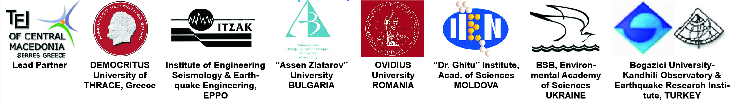
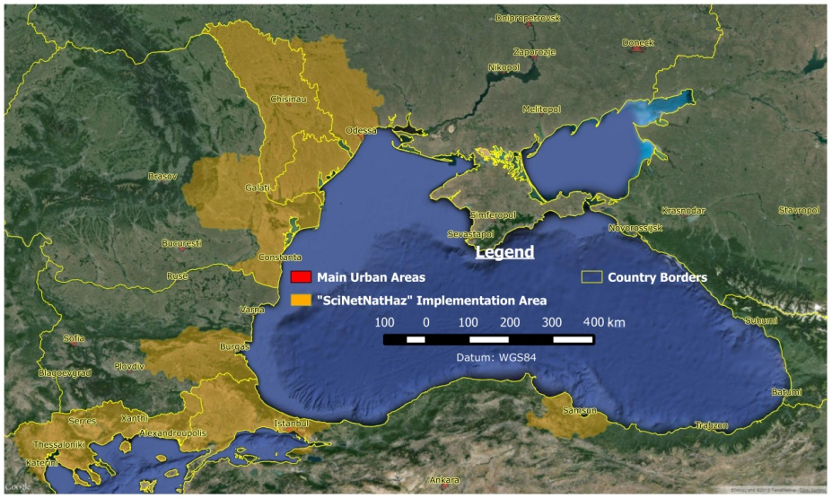
The Parthership!
Basic Info:
Areas of pilot implementation
Black Sea Basin Joint Operational Programme 2007-2013
Duration: 24 months
Total Budget (ENPI + IPA): 1.053.000,00
Total Grand (ENPI + IPA): 947 700,00
Start - End Dates: 01.05.2013 - 30.04.2015

Slide 21
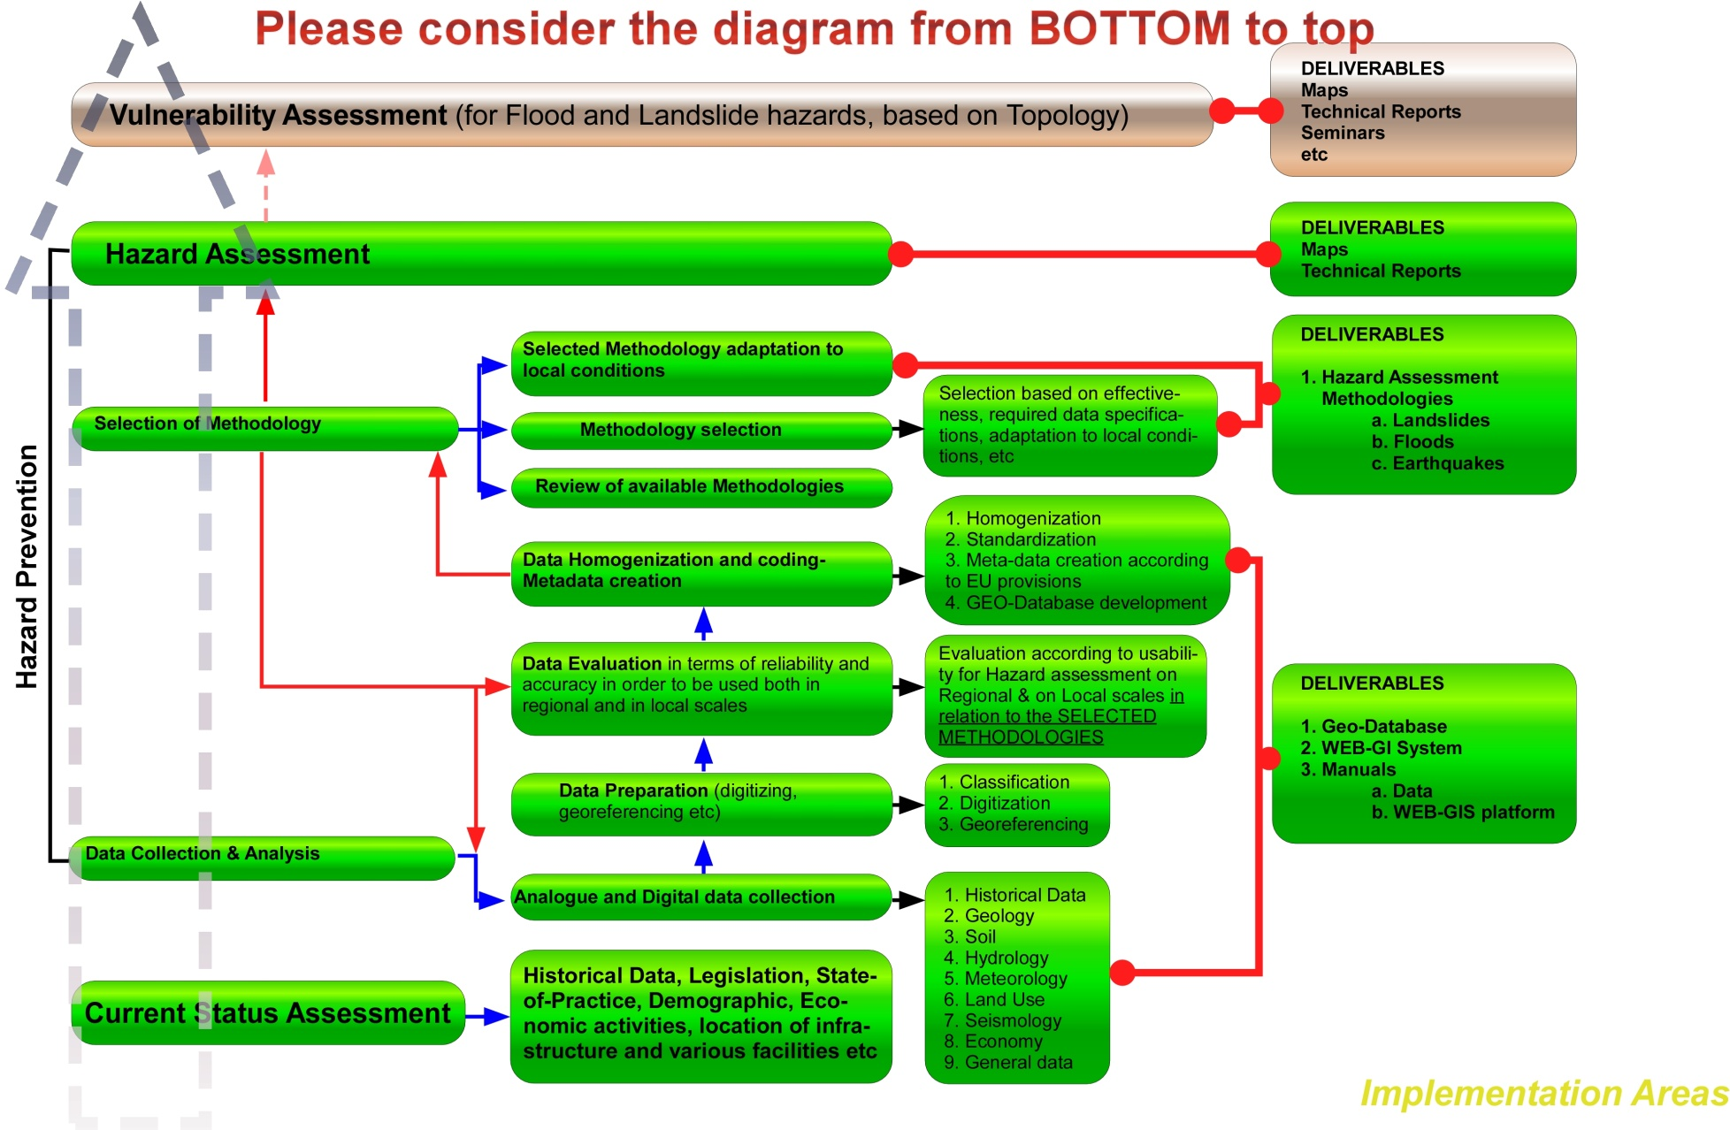
Scope of the SciNetNatHaz Project
Notes:
The basic idea goes like this….. Gather available data, Process and Homogenize them, make metadata, Decide about the methodology to be used for each of the ELF Hazards assessment, pilot implementation, seminars/training.

Slide 22
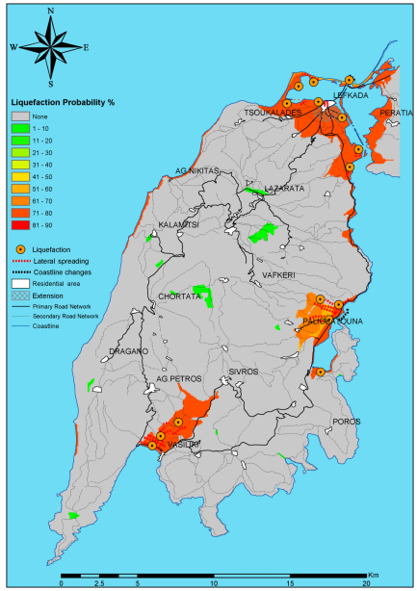
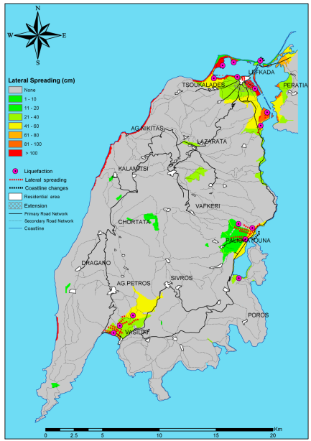
What is going to be provided …in terms of Hazard maps
Earthquake Hazard Assessment
Notes:
Ground Motion Maps as the one on the left, provide a measure of the Earthquake Hazard but can not be easily interpreted/converted into damage, loss, impact assessment. On the other hand, LIQUIFACTION and Lateral Spreading or Land Subsidence Maps provide information directly related to damage and can be used to support decisions regarding land uses and PREVENTION.

Slide 23
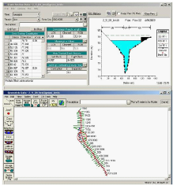
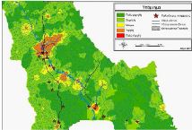
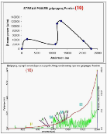
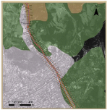
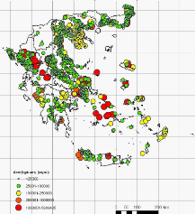
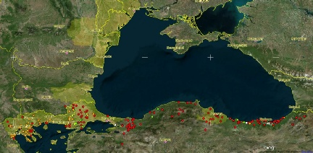
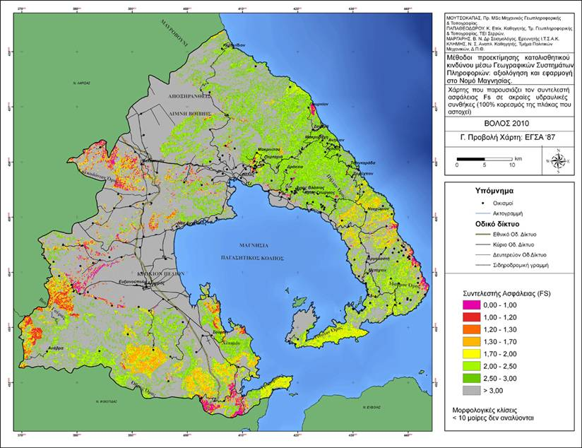
Some of the SciNetNatHaz Project scheduled Deliverables
Earthquake Hazard Assessment
Flood Hazard Assessment
1
2
Regional Scale
Local Scale
3
Data Inventory accessible via WebGIS
Landslide Hazard Assessment

Slide 24
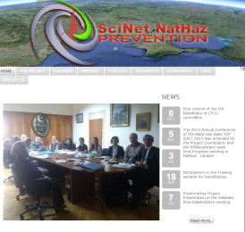
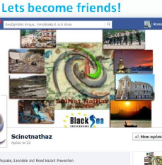


Open Invitation!
News & updates @: http://www.scinetnathaz.net/
Facebook: https://www.facebook.com/scinetnathaz.scinetnathaz
Follow us on Twitter: https://twitter.com/SciNetNatHaz
YouTube Channel: http://www.youtube.com/user/SciNetNatHaz
Notes:
We are inviting everybody to visit us, to check up on the project, to submit comments, suggestions….even to critisize (democracy permits it and evolution demands it!) so please do visit our contact points.

Slide 25
Selected References
Clark Ian, European Commission (2012): Towards an EU Policy on Disaster Management
Council of the European Union (2009): Council Conclusions on a Community framework on disaster prevention within the EU 2979th JUSTICE and HOME AFFAIRS Council meeting, Brussels, 30 November 2009
Commission of the European Communities (2009): COMMUNICATION FROM THE COMMISSION TO THE COUNCIL AND THE EUROPEAN PARLIAMENT EU STRATEGY FOR SUPPORTING DISASTER RISK REDUCTION IN DEVELOPING COUNTRIES, COM(2009) 84 final, Brussels, 23.2.2009
Directorate General for Research (2005): Extract of the DG RTD Unit I.4. Catalogue of Contracts topic: Natural hazards Flood Related EU Hazard Research Projects (Framework Programme 5 (1998 – 2002) “PROGRAMME ENVIRONMENT AND SUSTAINABLE DEVELOPMENT” and Framework Programme 6 (2002 – 2006): “PROGRAMME SUSTAINABLE DEVELOPMENT, GLOBAL CHANGE AND ECOSYSTEMS”).
Commission DG Environment (2008): “Assessing the Potential for a Comprehensive Community Strategy for the prevention of Natural and Manmade Disasters”. Final Report, March 2008.
European Commission: Research and innovation (2006): Workshop on “RESEARCH: Floods!: Managing the risks of flooding in Europe. Conference Minutes.
EUROPEAN COMMISSION RESEARCH DIRECTORATE-GENERAL (2003): Background Information for Press Release: “Floods: European research for better predictions and management solutions”, Dresden, 13 October 2003.
Ghazi A., Balabanis P., Casale R. and Yeroyianni M (1997): Highlights of Results from Natural hazards Research projects -1997. European Commision, Directorate General XII, Science, Research and Development, Directorate D-RTD Actions: Environment.
Ionescu E. Michail, Soare R. Simona, Niculescu G, Gramada Angela (2012): Comparative study on early recovery and consequence management in the aftermath of Natural and Man-made Disasters in the Greater black Sea area (GBSA)
Lungu D. (2008): Collaborative research and Lessons for future earthquake risk reduction in Romania. IPRED-International Platform for Reducing Earthquake Disaster. UNESCO headquarters, Paris, July 8-10, 2008.

Slide 26

Natural Hazard Prevention and Management in the wider Black Sea area: the SciNetNatHaz Project
Thank You!
Acknowledgments:
The research was partially funded by the EU within the context of the
Black Sea Basin Joint Operational Programme 2007-2013

